Slide 1

Kultra mega stores
Inventory Analysis

Slide 2
Kultra Mega Stores (KMS), headquartered in Lagos, specializes in office supplies and furniture. Its customer base includes individual consumers, small businesses (retail), and large corporate clients (wholesale) across Lagos, Nigeria.

Slide 3
Project Overview
This inventory analysis aims to identify the best-selling products, best performing regions, most valuable customers and low performing regions.
Most importantly to estimate cost of shipping and relate it to the order priority and the shipping mode.

Slide 4
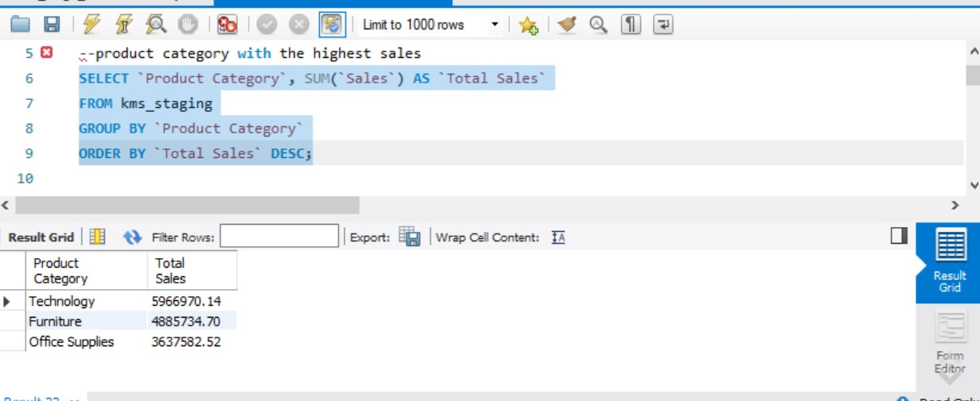

Slide 5
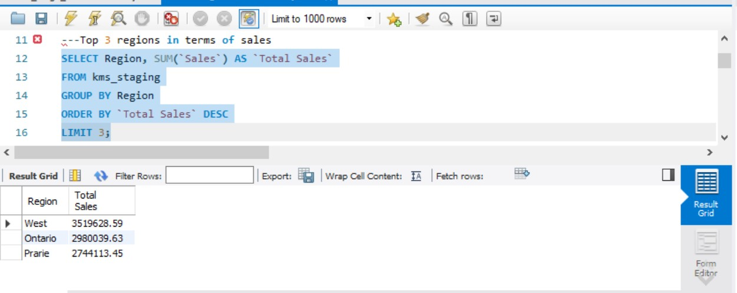

Slide 6
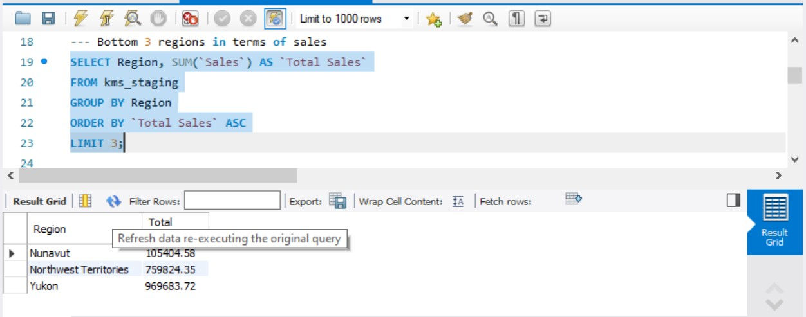

Slide 7
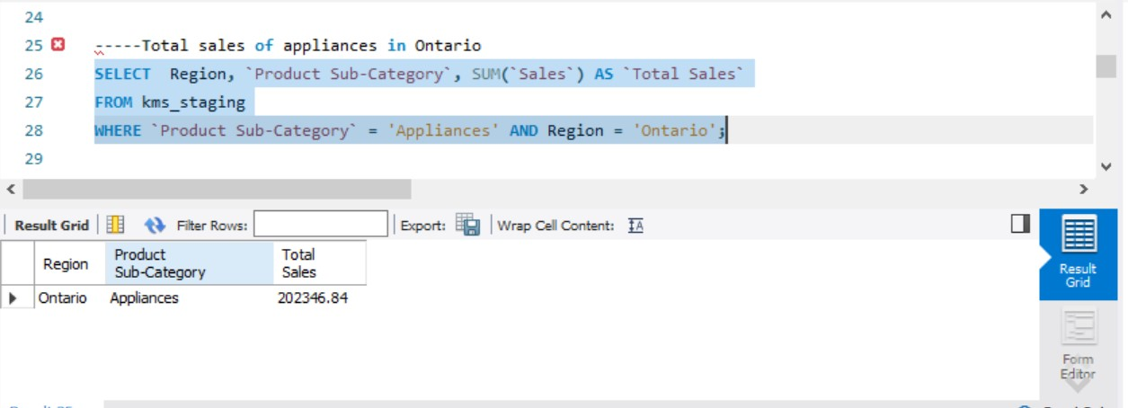

Slide 8
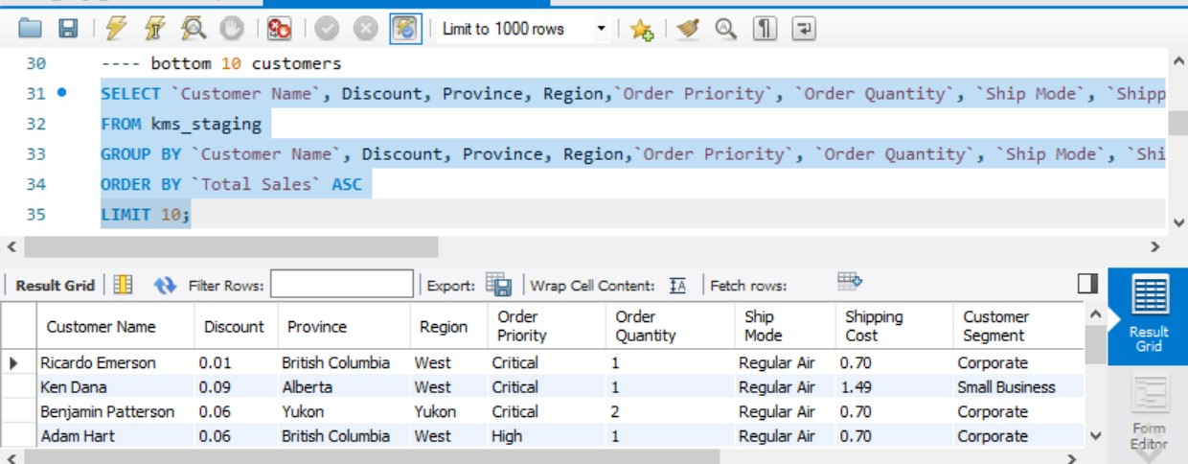

Slide 9
Recommendation on increase in patronage from the bottom 10 customers
The bottom 10 customers bought the same line of product category; thus Management can look at:
suggesting complementary products
sending out email or mail campaigns with exclusive offers and promotions specifically designed for this group
reaching out to those who haven’t purchased recently with special offers to encourage them to return
gathering feedback about their satisfaction with previous purchases and offer assistance with any issues they may be experiencing.
This will also be used in improving products and services. Address any concerns or complaints promptly and efficiently to prevent further dissatisfactions. Ask them what other products they might be interested in.

Slide 10
assigning a specific point of contact for this group to provide personalized support and build a stronger relationship
offering them trials and promotions to try new products before making purchases
using their names in communications and acknowledge their past purchases
sending thank you notes to demonstrate that they are valued customers
consider creating a forum or online community where they can connect with other customers and share experiences

Slide 11
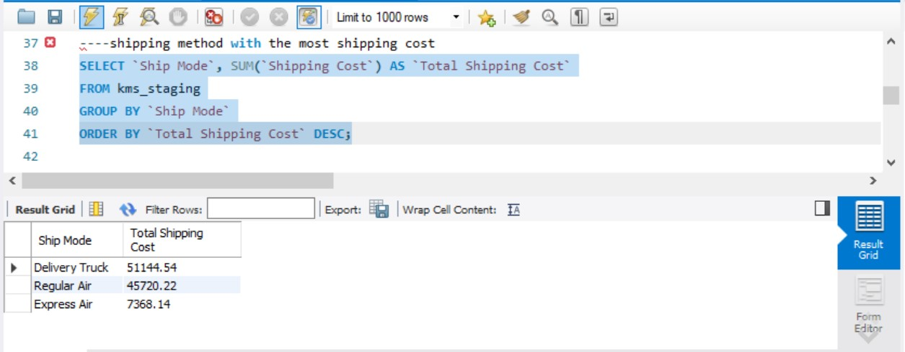

Slide 12
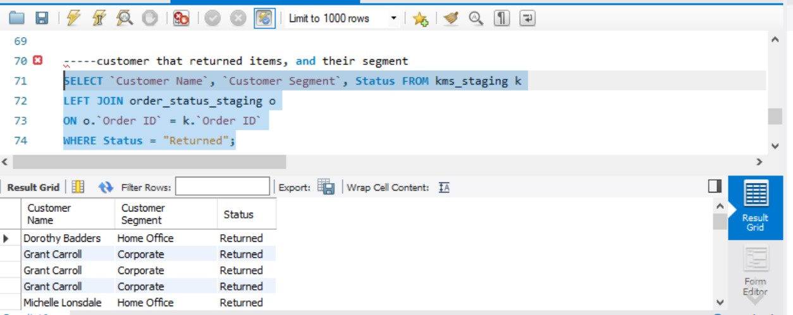

Slide 13
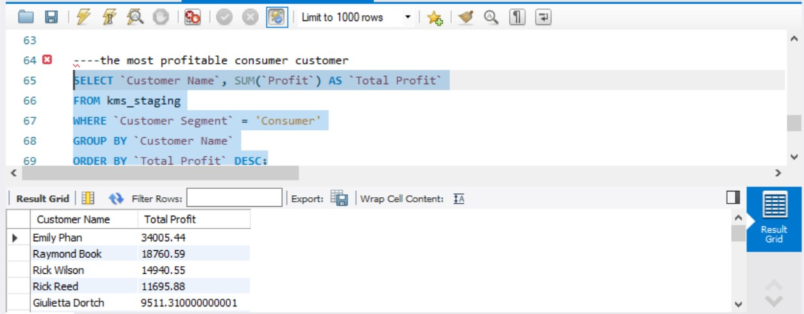

Slide 14
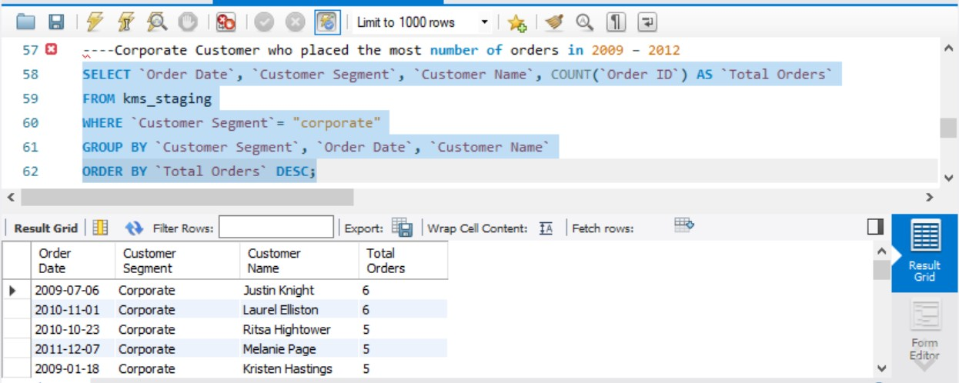

Slide 15
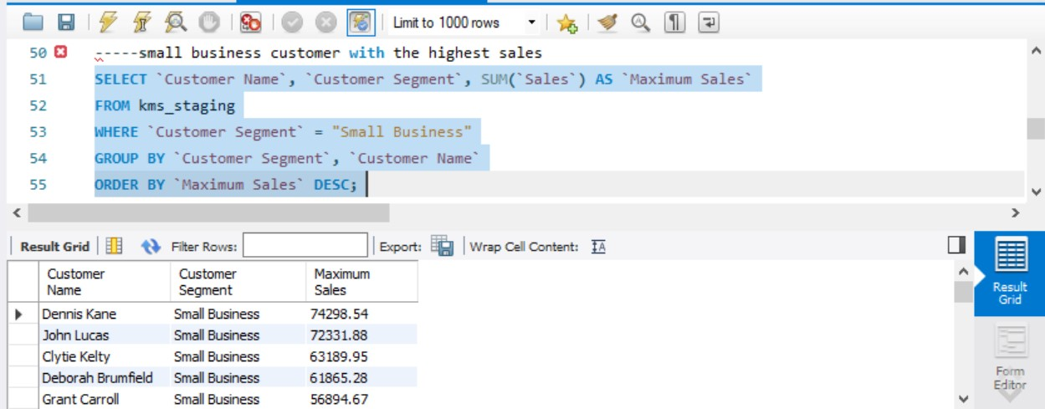

Slide 16
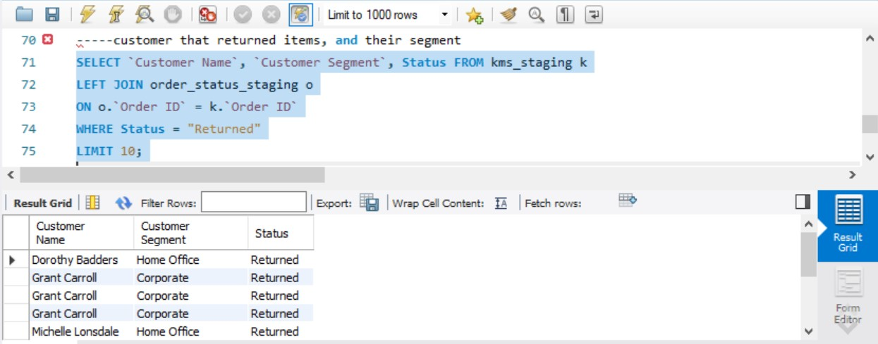

Slide 17
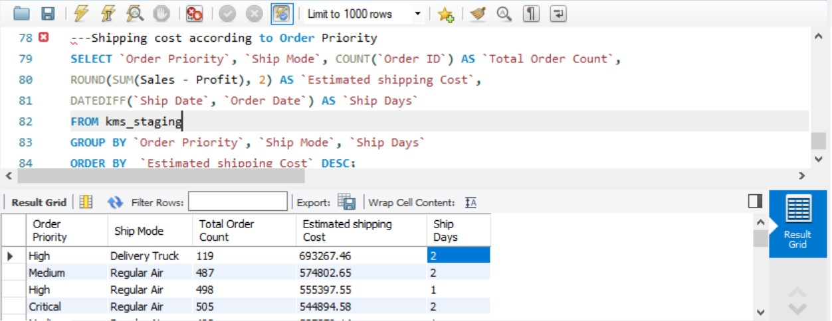

Slide 18
Based on the analysis, the company appropriately spent shipping costs based on the Order Priority as it was revealed that the highest shipping cost were from the high, medium and critical order priority.

